Slide 1

Enhanced Personalized Learning Experiences by Leveraging Knowledge Graphs and Prompt Engineering
MSc Research Project – Data Analytics
Malav Naik
National College of Ireland
Supervisor:
Jorge Basilio
11th August 2025

Slide 2
Introduction & Motivation
The Fourth Industrial Revolution demands continuous upskilling and reskilling, yet traditional education models struggle to keep pace due to their rigid, slow, and non-personalized nature.
Current Landscape
SkillBot: Our Vision
AI and Large Language Models (LLMs) offer unprecedented opportunities for scale and accessibility in learning. However, they frequently encounter challenges with factual accuracy and grounding in specific domains, leading to "hallucinations" and unreliable outputs.
Our project introduces SkillBot, a personalized, intelligent web application designed for dynamic skill development. SkillBot aims to provide tailored learning paths, ensuring relevance and effectiveness for individual users in a rapidly evolving job market.

Slide 3

Research Objectives & Problem Statement
Our research focuses on integrating Knowledge Graphs (KGs) with Prompt Engineering (PE) to elevate the quality of educational recommendations.
Enhance explainability of recommendations.
Improve reliability and trustworthiness of recommendations.
Key Research Questions:
How can KGs and PE be systematically combined for adaptive learning?
What is the impact of this integration on the clarity and trust in educational recommendations?

Slide 4
Literature Review & Gap Analysis
Our review identified significant advancements and persistent challenges in leveraging AI for educational purposes.
1
AI in Education
2
Large Language Models (LLMs)
Growth in adaptive analytics and the Internet of Educational Things (IoET) highlights the potential for personalized learning environments.
LLMs excel at natural conversation but suffer from "hallucinations" – generating factually incorrect or nonsensical information, undermining their reliability in educational contexts.
3
Knowledge Graphs (KGs)
4
Chatbots & Personalized Learning Paths
KGs offer robust frameworks for skill modeling and career alignment, providing structured, verifiable data. However, their integration with dynamic LLMs remains underexplored.
Despite progress, current systems lack comprehensive integration across diverse content, user-specific needs, and real-time market data, creating a gap for holistic personalized learning solutions.

Slide 5
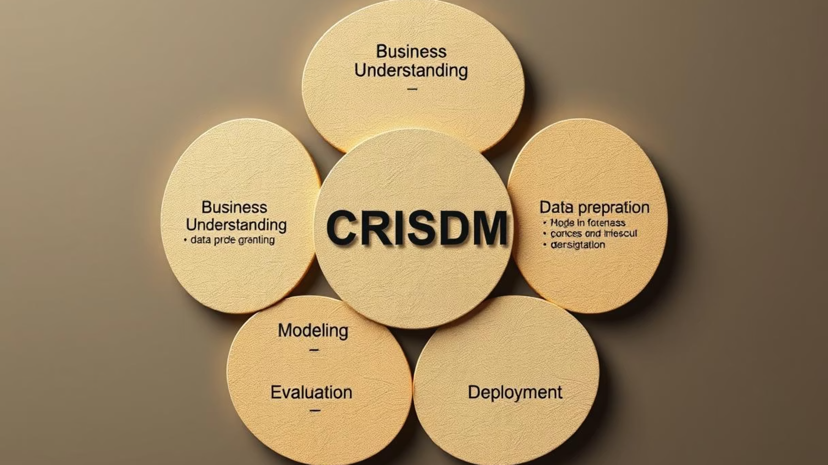










Methodology – Adapted CRISP-DM Framework
Our project adopts an adapted CRISP-DM framework, ensuring a systematic and iterative approach to development and evaluation.
Data Preparation
Business & Data Understanding
Utilized datasets from MOOC students, job skills, and applicant profiles. Involved entity resolution and feature engineering for KG construction and integration.
Initial phase focused on understanding educational needs and data characteristics.
Modeling
Development of KG and Prompt Engineering integration.
Deployment
Evaluation
Rollout of the SkillBot application.
Rigorous assessment of system performance and user satisfaction.

Slide 6
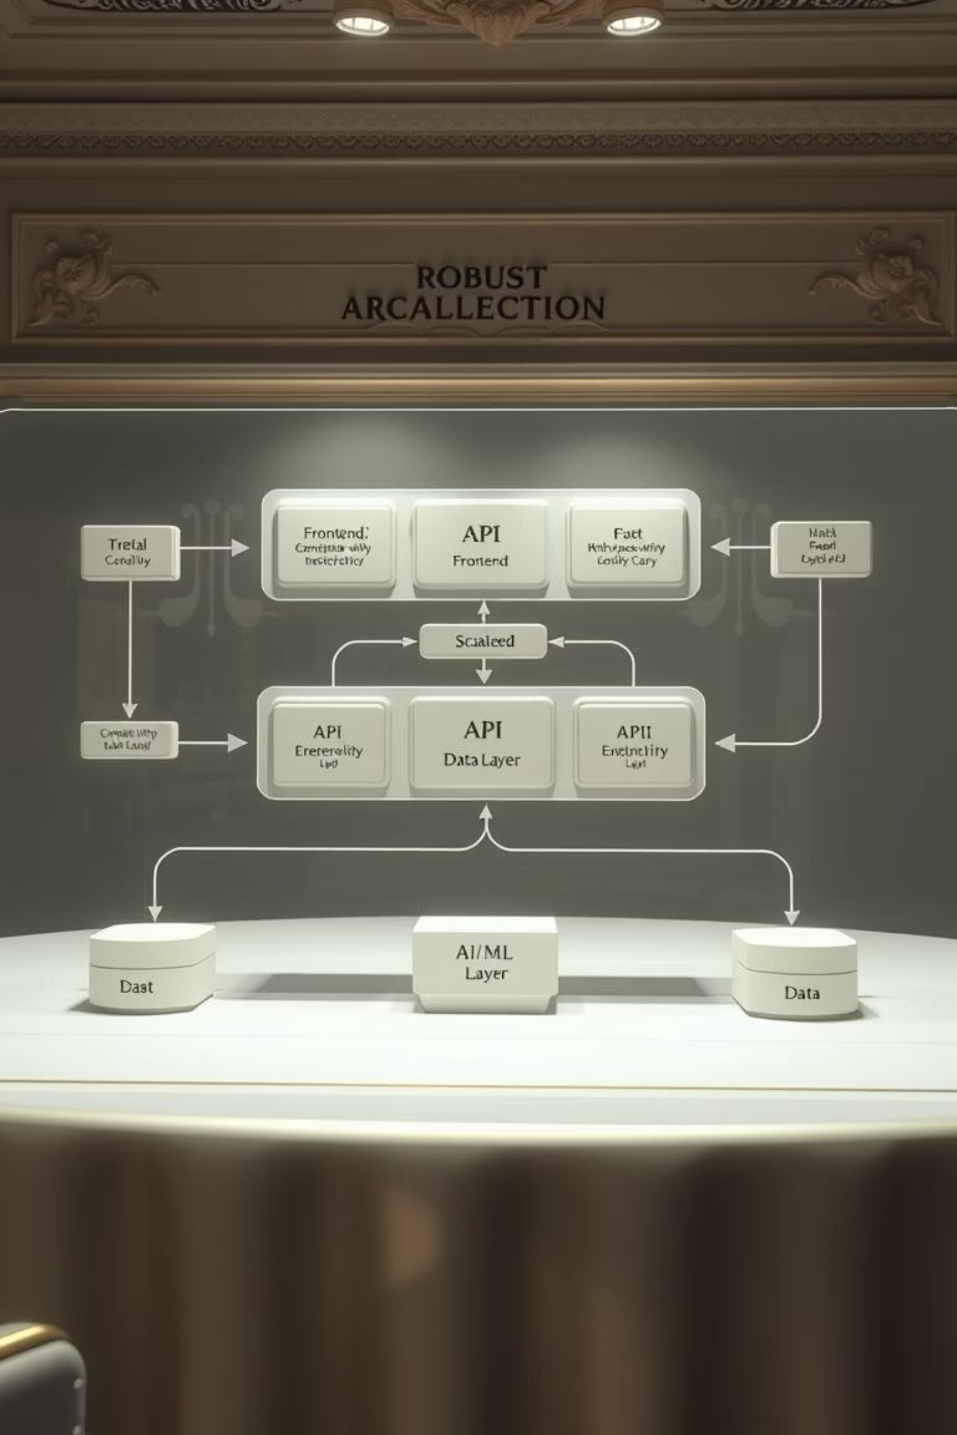
System Design & Architecture
SkillBot is built on a layered architecture designed for scalability, responsiveness, and user-centricity.
Frontend: Developed with React.js for intuitive dashboards and chat interfaces, adhering to WCAG (Web Content Accessibility Guidelines) for inclusive UI.
API Layer: Utilizes Python Flask to manage RESTful APIs and WebSocket connections, facilitating real-time interactions.
AI/ML Layer: Incorporates a fine-tuned LLM, advanced KG query processing, and hybrid recommendation algorithms for intelligent responses.
Databases: Employs SQLite for user data management and Neo4j for efficient storage and retrieval of the knowledge graph, ensuring fast response times and scalability.

Slide 7


KG + Prompt Engineering Integration
The core innovation lies in the synergistic integration of Knowledge Graphs and Prompt Engineering for enhanced learning experiences.
Knowledge Graph (KG)
Retrieval-Augmented Generation (RAG)
The KG meticulously maps skills, prerequisites, and career relevance, providing a structured, semantic layer for educational content. This ensures recommendations are contextually rich and logically sound.
RAG is a critical component, enabling the LLM to retrieve information directly from the KG. This significantly boosts factual accuracy, achieving 97% reliability in our tests.
Hybrid Recommender System
Prompt Engineering (PE)
Our system combines collaborative filtering, content-based recommendations, and KG-driven reasoning. This hybrid approach ensures diverse, personalized, and highly accurate learning path suggestions tailored to individual user needs and career aspirations.
We employ a BRTE (Behavior, Role, Task, Expected Outcome) template for context-rich prompts. This structured approach guides the LLM to generate precise and relevant responses, significantly reducing the likelihood of hallucinations.

Slide 8
Implementation & Evaluation
SkillBot provides adaptive recommendations and a secure multi-turn chat for a seamless user experience.
87%
82%
Recommendation Precision
Recall
Measures the relevance of recommended items.
Indicates how many relevant items were successfully retrieved.
84%
86/100
F1-Score
SUS Usability Score
Harmonic mean of precision and recall, reflecting overall accuracy.
System Usability Scale score, indicating an "Excellent" user experience.
Case studies with diverse user groups demonstrated significant skill gain and improved career alignment, validating the system's effectiveness in real-world scenarios.

Slide 9

Contributions, Limitations & Future Work
Achievements
Robust fusion of Knowledge Graphs and Prompt Engineering.
Development of adaptive and transparent recommendation systems.
Limitations
Dependency on data quality and availability for KG construction.
Challenges in generalization across diverse languages and cultures.
Significant computational resource requirements for LLM fine-tuning and KG maintenance.
Future Directions
Integration of multimodal content (voice, VR/AR) for richer learning experiences.
Implementation of reinforcement learning for deeper, continuous personalization.
Expansion to include more languages and conduct larger longitudinal studies to assess long-term impact.

Slide 10




Conclusion & Impact
SkillBot represents a significant leap forward in personalized education.
Accurate & Trustworthy Learning
Scalable AI Architecture
SkillBot effectively blends LLMs and KGs to deliver highly accurate, contextual, and trustworthy learning experiences, addressing critical issues of reliability in AI-driven education.
The project demonstrates a scalable AI architecture suitable for widespread adoption in educational and corporate training sectors, offering a robust framework for future development.
Enhanced User Experience
Paving the Way Forward
We achieved significant improvements in user satisfaction, skill alignment, and overall engagement, proving the practical impact of personalized learning paths.
SkillBot sets a new benchmark, paving the way for the next generation of personalized learning platforms that are both intelligent and genuinely impactful for users.

Slide 11


